Slide 1
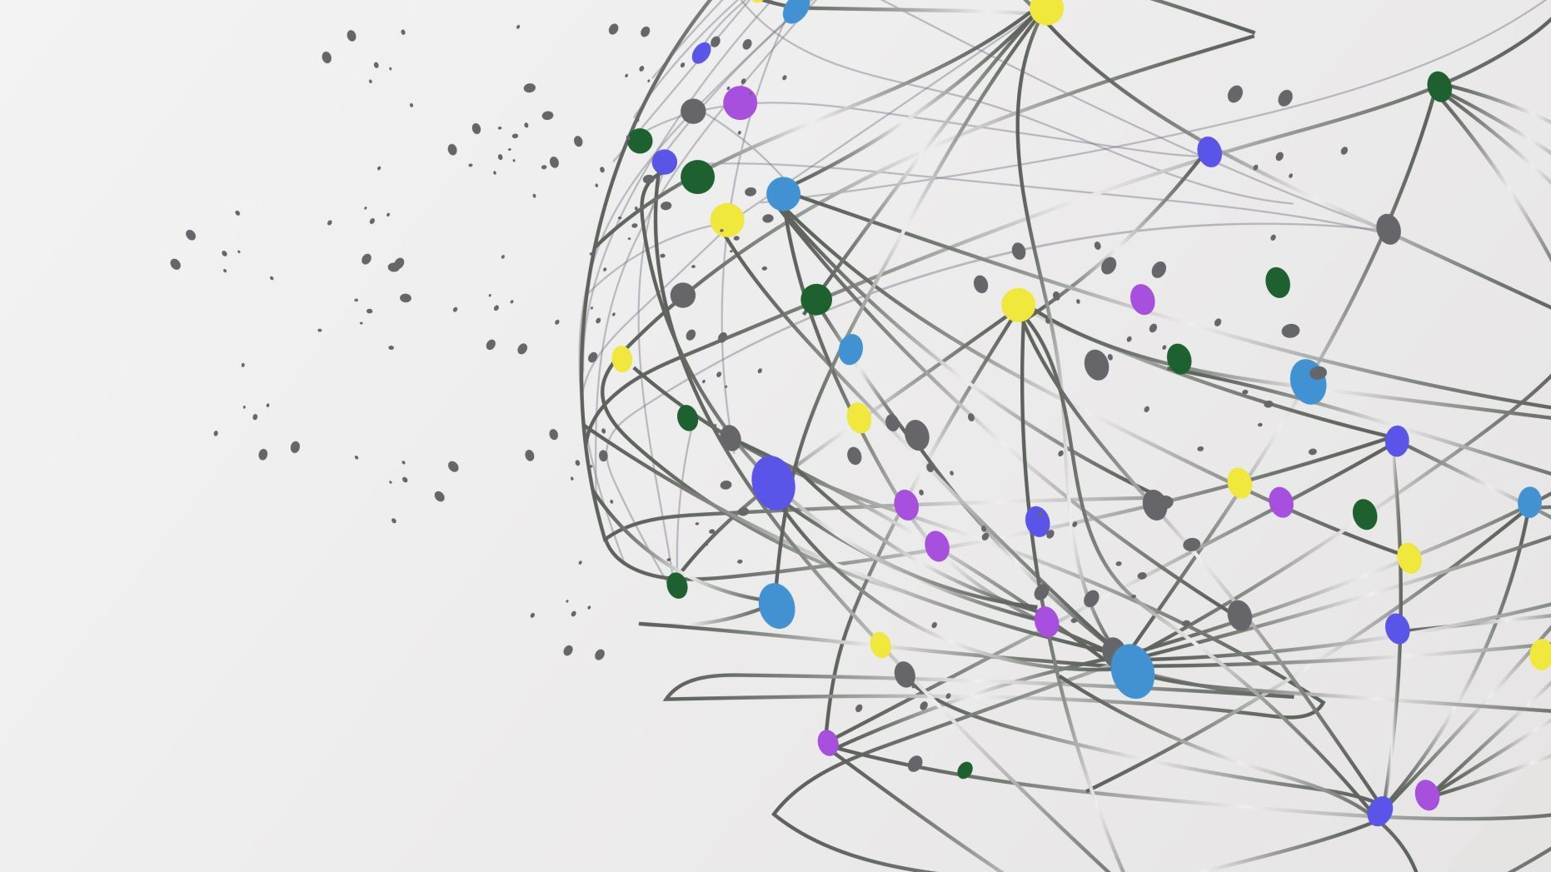
FlexType EMG Keyboard
Half-Byte Solutions
Julia Johnson
Giancarlos Hernandez Mendoza
Jalen Tottress
Kejon IverY

Slide 2
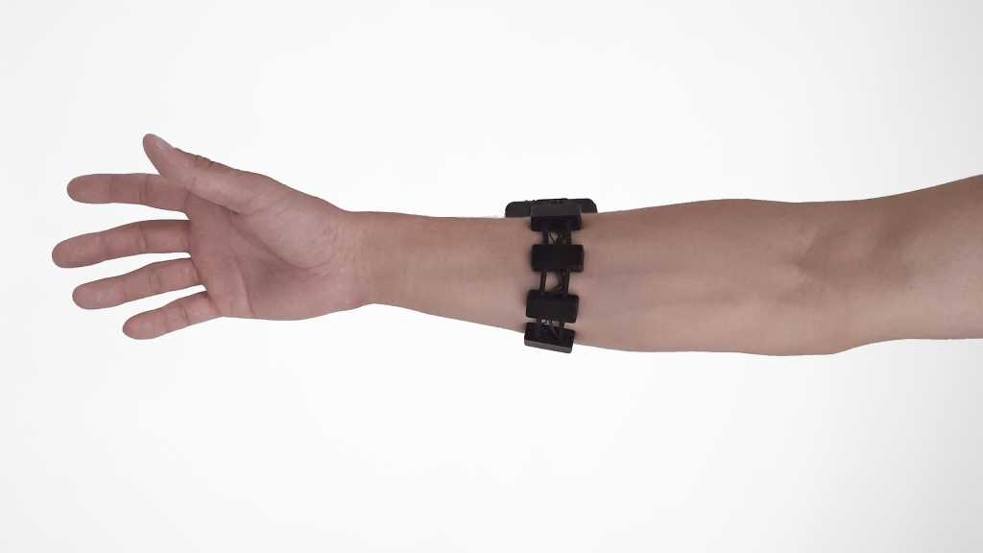
Project Overview
Market Problems
Our Solution
People with neurological disabilities have difficulty typing on standard keyboards
Voice-to-text is not private, and often does not work for people in loud areas, noise-restricted areas, or for people with diseases like Parkinson's
Other technologies, like eye-tracking devices, are often expensive and difficult to carry around
A lightweight, wearable electromyography (EMG) armband worn around the arm
The EMG picks up signals from muscle movements and sends them to our PCB
The PCB uses a custom made CNN model to determine which gesture is being made
Gestures are converted into letter groups, then passed into the existing FlexType Word Prediction model to type in the predicted word

Slide 3

Milestone #1 Goals & Objectives
Software
Hardware
Create Initial Model Training Set
Define 10-12 Possible Gestures
Collect EMG Data from 12 Volunteers with Commercial EMG
Compile EMG Data into One Dataset
Research and Plan Gesture Recognition Model
Research Existing Gesture Recognition Algorithms
Determine Which Model(s) is best to use
Determine How Letter Groups Should Be Divided amongst Gestures
Configure FlexType Word Prediction Model on Raspberry Pi
Research and Understand Existing FlexType Model
Download/ Gain Access to Word Prediction Model on Raspberry Pi
Update Input Format on Existing Model to Match our Inputs
Design and Order PCB Board
Design PCB in EDA Software
Draft PCB casing in 3D Printing Software
Order PCB Board
Integrate PCB with Raspberry Pi

Slide 4

Building Our Database
Old Method
New Method
We record 12 gestures, 10 times each, at 1 second intervals
We record 10 seconds of "at rest" to serve as a control
Each gesture had a folder containing the data from each subject
Record 12 gestures, 10 times each, at 7 second intervals
Record 2 seconds of rest, 3 seconds of gesture, 2 seconds of rest
Reorganize folders so that parent folders are each subject, and contents are each gesture from that subject

Slide 5
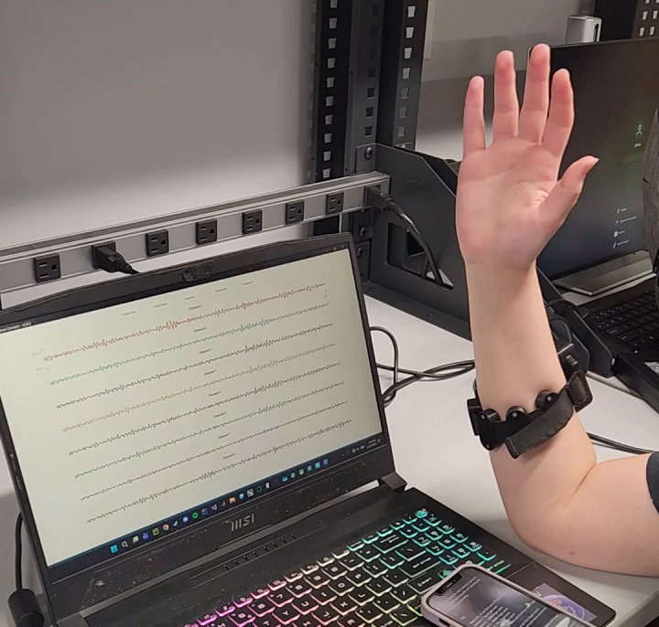
Gestures and EMG Demo Video

Slide 6
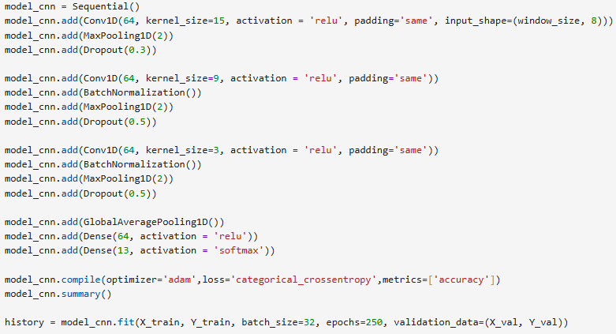
Gesture Recognition Model
Processing Data
Notch Filter: 60Hz
Bandpass Filter:
Low: 10Hz
High 200Hz
Sampling Rate: 500Hz
Window Size: 125 (250ms)
Segmenting data
Step size: 62
~50% overlap
From EMG sensor data, only used the 8 columns of Filtered Channels
Data split between 80% training and 20% testing
X value: Segmented Data
Y value: Gesture Number Label
AI Model
TensorFlow
1D Convolutional Neural Network model
3 Convolutional Layers
250 epochs
Kernel sizes: 15 → 9 → 3
Input Shape: (125, 8)
Dropout: 0.3 and 0.5 to reduce overfitting
Dense Layer:
GlobalAveragePooling()
Softmax Activation: 13 classes
Loss: Categorical_crossentropy (One-Hot Encoded Labels)

Slide 7
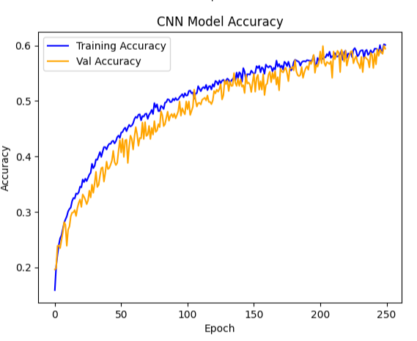
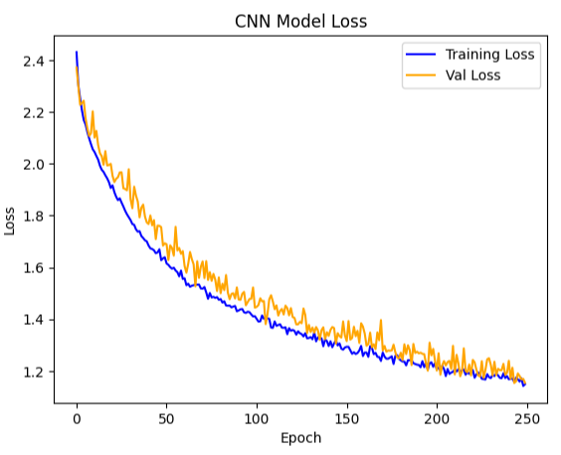
Current Model Performance
Overall Performance
Validation Accuracy: ~55 - 60%
Training Accuracy: ~58 - 60%
Validation accuracy is similar to the training accuracy
Validation and Training Loss: ~1.2
Improvement slows down around 130 epochs
Model starts plateauing after 200 epochs
Validation accuracy and loss is slightly noisy/spiky

Slide 8
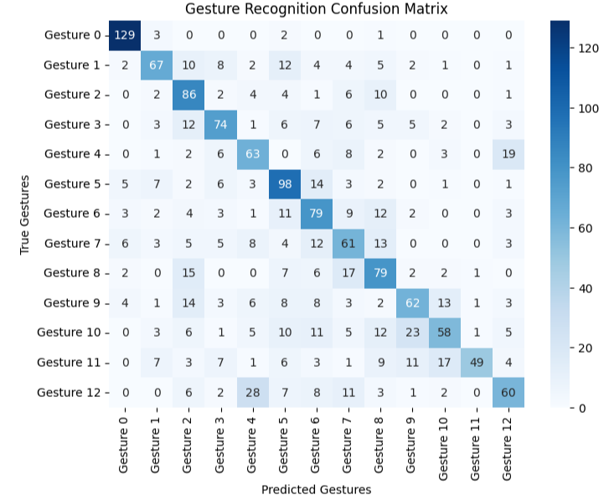
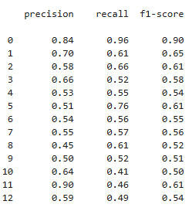
Current Model Performance
Individual Gesture Performance
Gesture 0 is the control gesture (Rest)
Control Gesture is performing well and has an accuracy of 90%
Best Overall Performing Gestures: 1, 2, 5, 11
Have F1 score higher than 60%
Most Misclassified Gestures: 4, 5, 8, 9
Have precision lower than 55%
Most Missed Gestures: 10, 11, 12
Have recall score lower than 50%

Slide 9
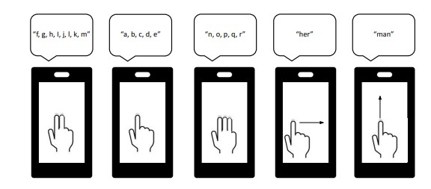
Existing FlexType Model
The FlexType Model is a word prediction model created by Dr. Dylan Gaines
The model assigns letter groups to gestures, then uses a n-gram language model to predict what word is being typed
The current model was designed for a touch screen, and used 4 different gestures
We will alter how it takes an input to assign 8-10 different gestures to various letter groups and controls
Non-letter controls will be 'start/stop', 'space/ enter', 'delete', and 'swipe'

Slide 10
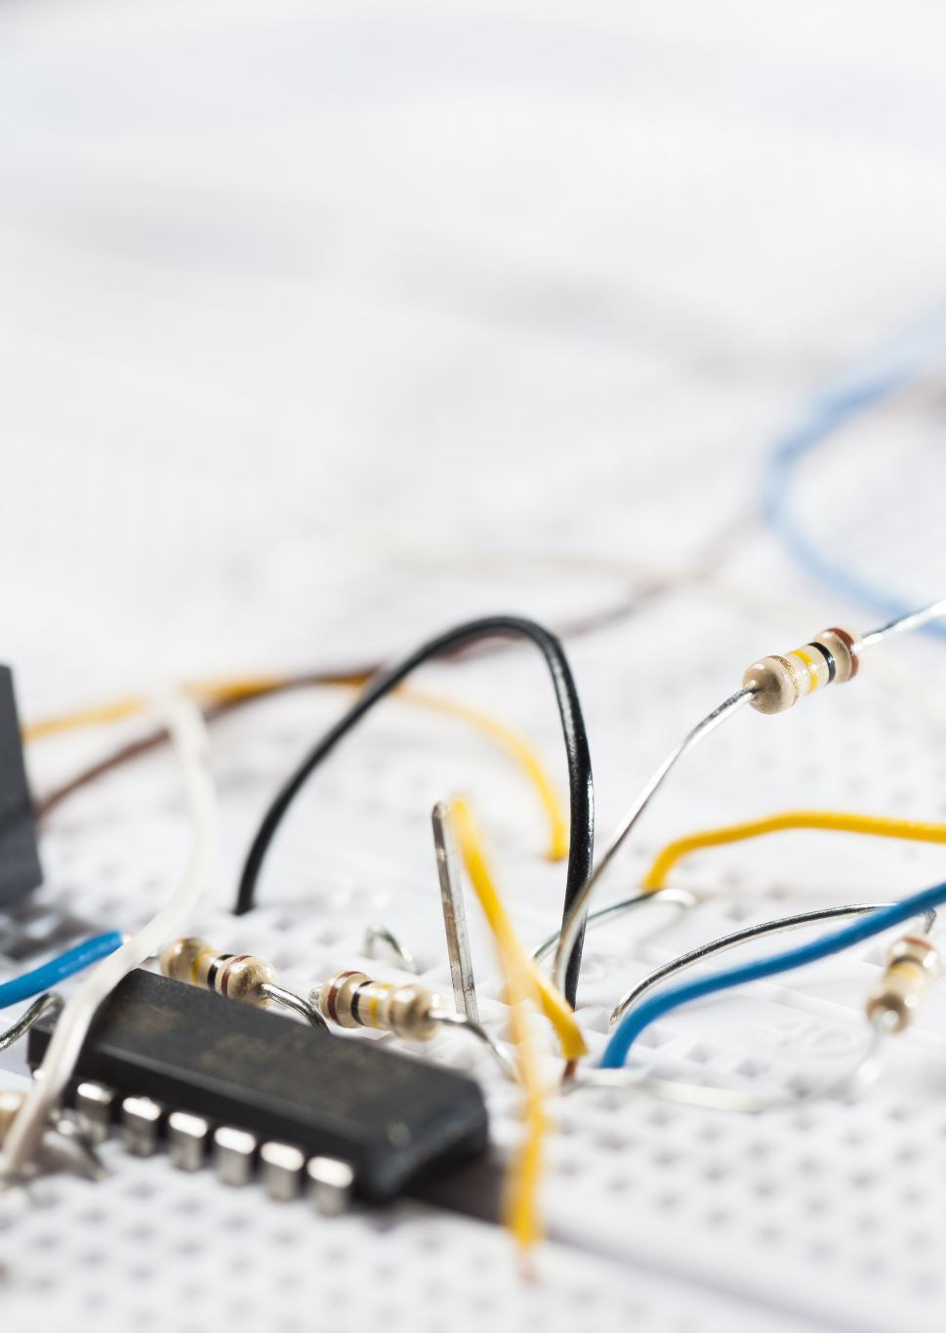
PCB Design Milestone
Goal: Start PCB design and create a BOM list for purchasing the components.
Designed two PCBs, a control board and an electrode/sensor board.
Control board gathers the EMG data from the electrode boards and sends it to a Raspberry Pi
The MCU coverts the ADC SPI data to USB for processing
Electrode board contains the electrodes for collecting the EMG (Electromyography) data and sends it to the control board
After the PCBs designs are complete, fill out a BOM list to purchase the components
List made for purchasing 2 Control boards and 5 electrode/sensor boards

Slide 11
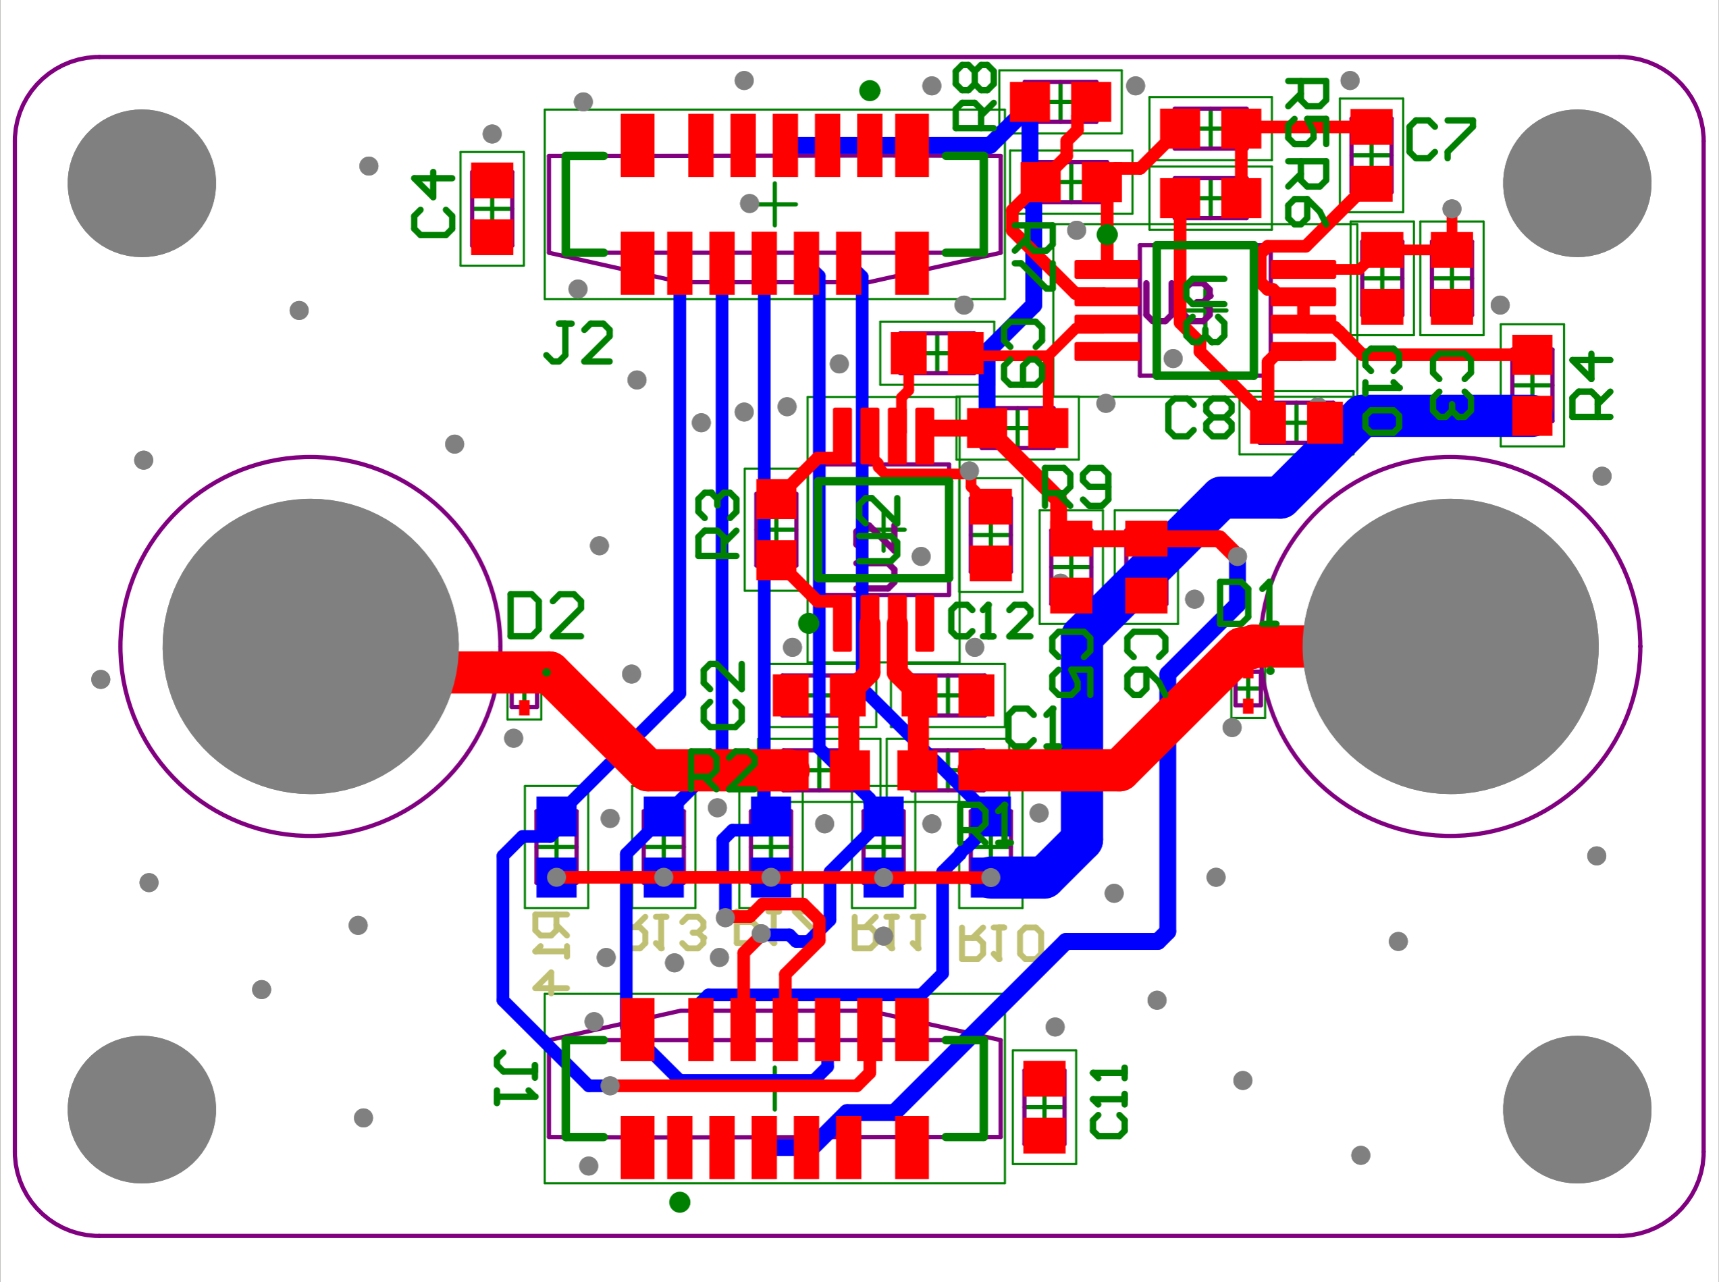
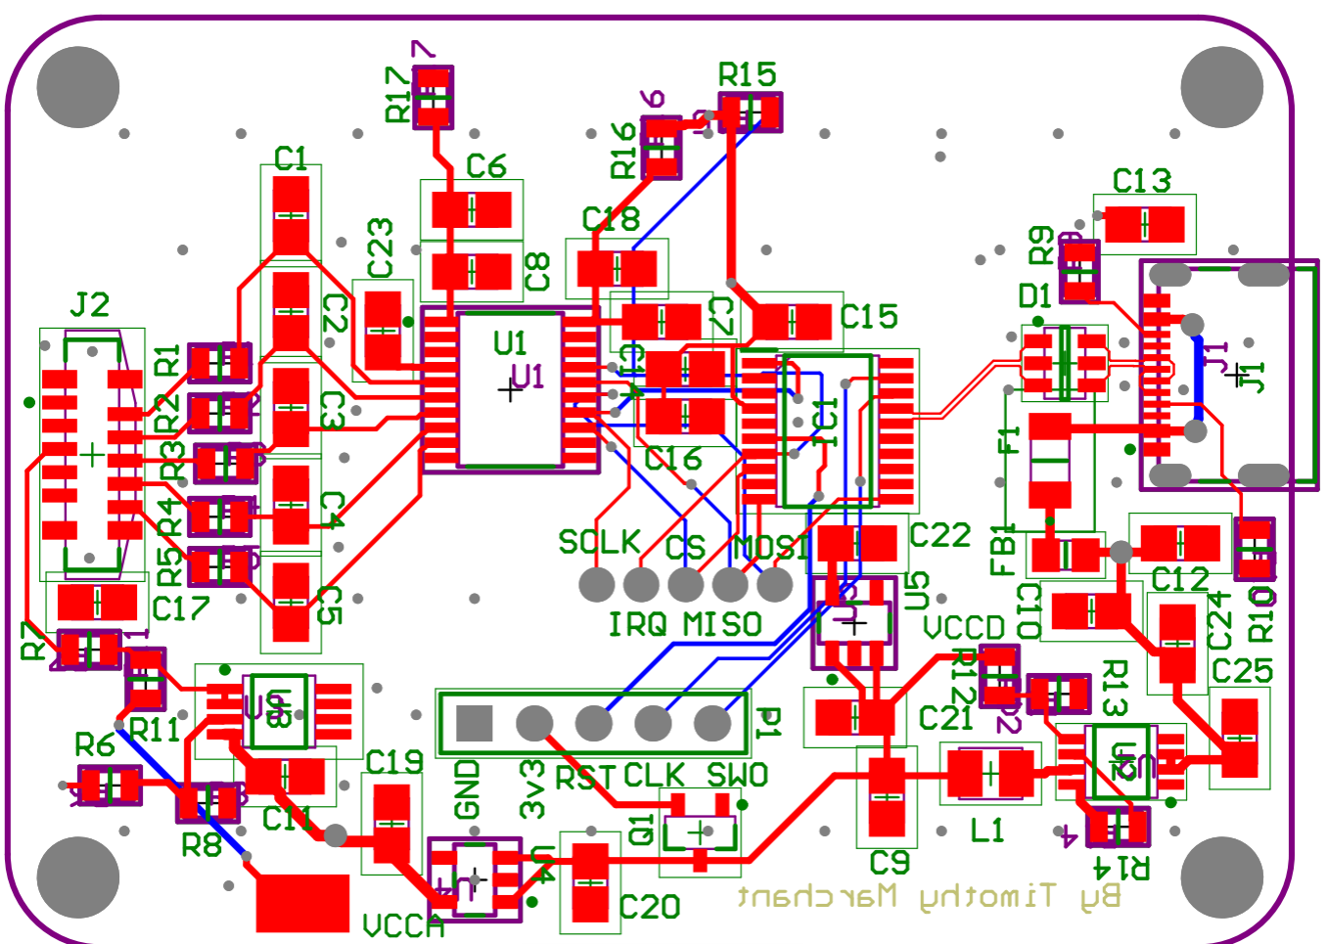
PCB Designs
Electrode Board
Control Board

Slide 12
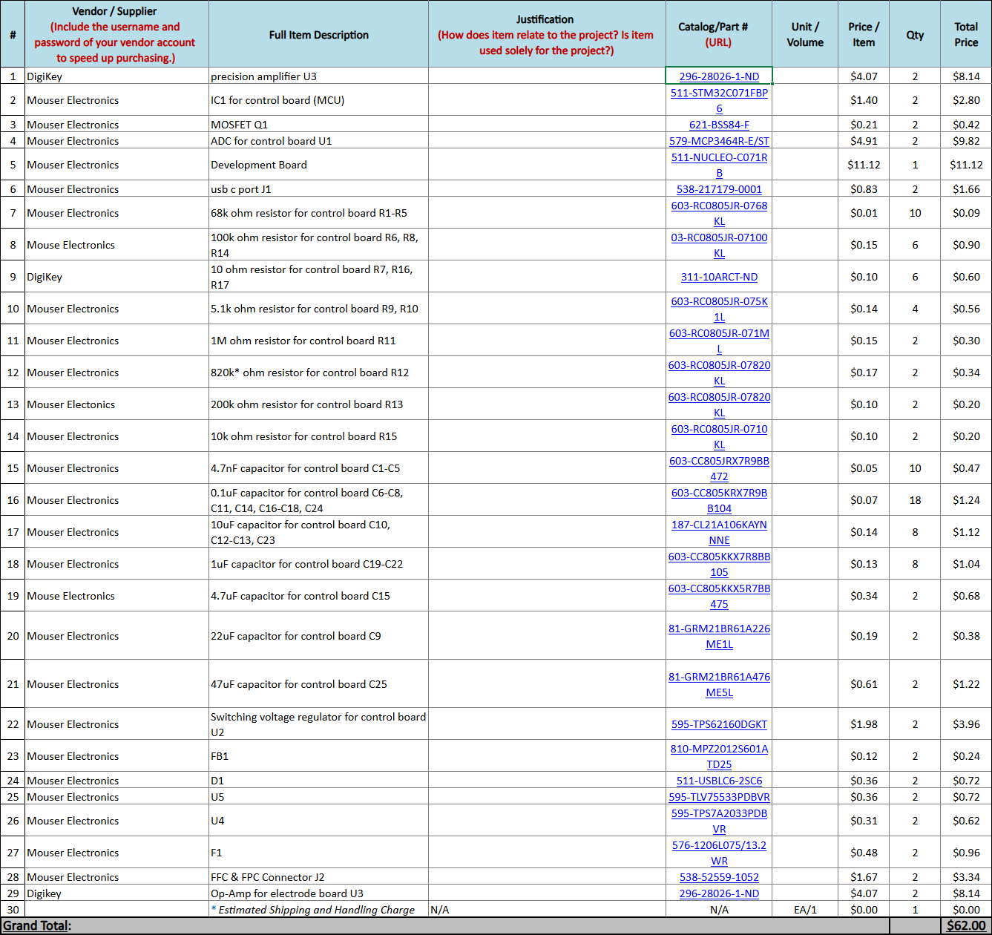
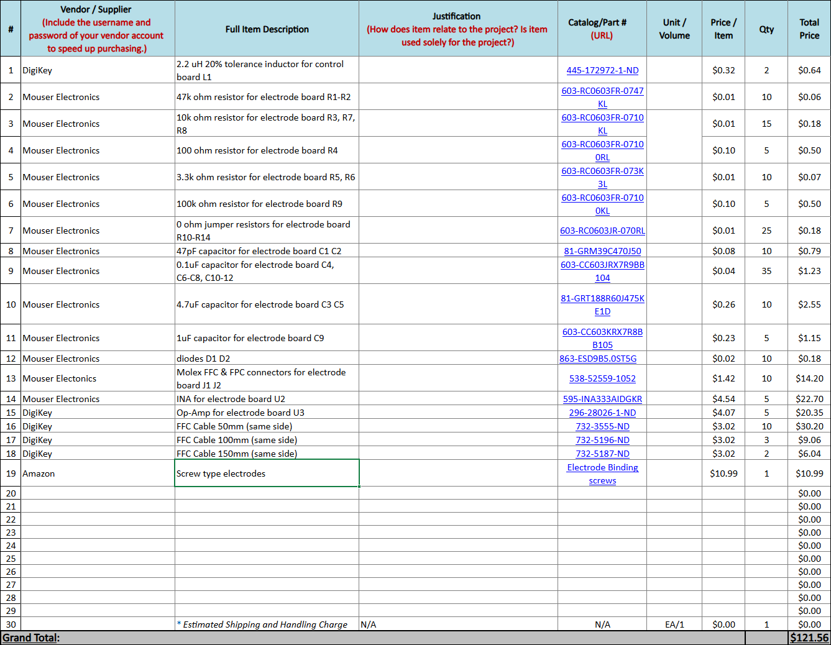
PCB Designs: BOM List
Electrode Board
Control Board

Slide 13
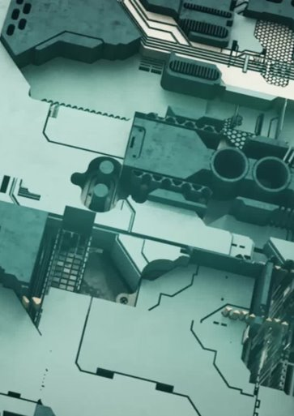
Case Design Milestone
Goal: Start a rough draft of the 3D enclosures that will house both our PCBs
Install Fusion 360
Watch YouTube videos on how to use Fusion 360
Upload the PCB step files into Fusion
Start building the enclosure
Need to be as small as possible
Have cut-outs for the FFC cables and ports
Needs ears on the sides for attaching an armband

Slide 14
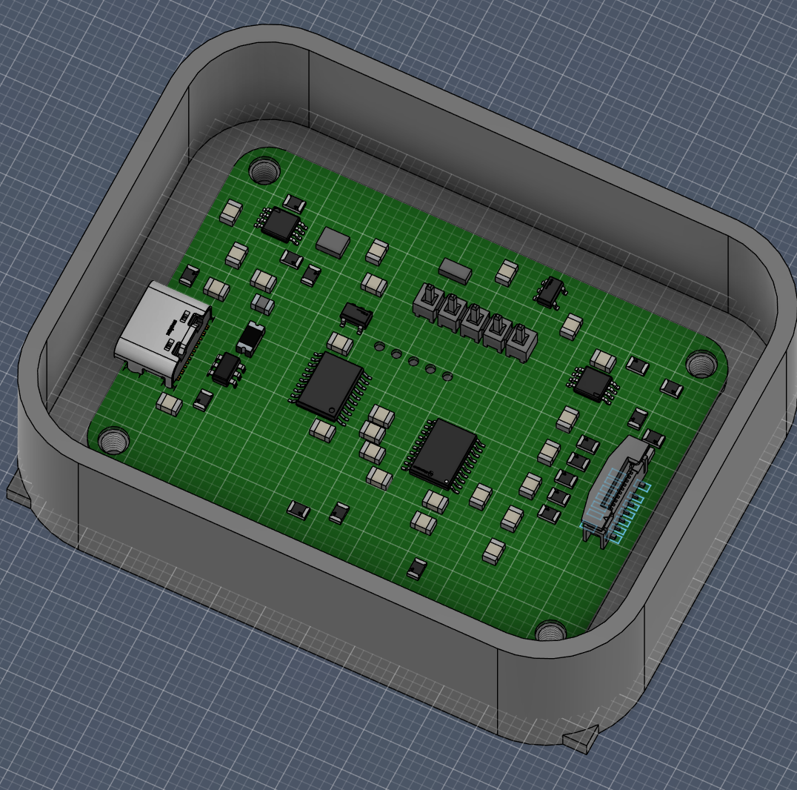
Case Design Control Board PCB

Slide 15
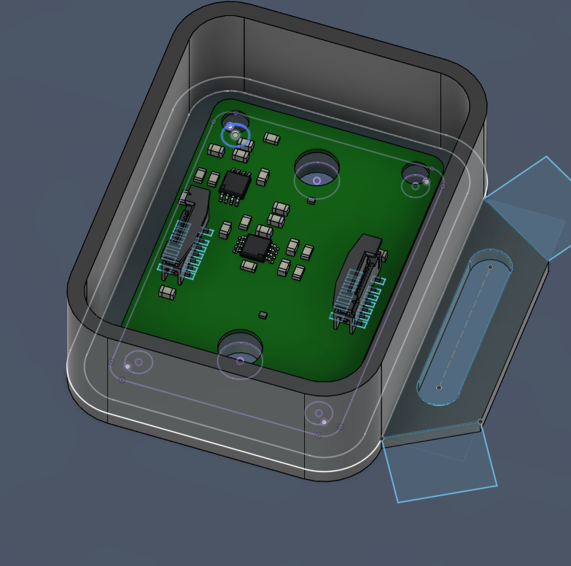
Case Design Electrode Board PCB

Slide 16
PCB Design Takeaways
Pricing
2 Control board components cost ~$62
5 Electrode board components cost ~$122
Learning 3D Modeling
Basic box and lid design is complete
However, some parts (the base) is sticking out. Need to learn how to get rid of this.
Need to make cut-outs for the cables and electrodes
Potentially have some creative design choice (Ex. team name on the enclosure)
Connectivity
The Electrode Boards will all be daisy chained together then connected to the Control board
Using FFC Cables
We are buying 5 electrode boards, but the goal is for the final design to have no more than 2 electrode boards in the system

Slide 17

Challenges and Obstacles
SoftWare
HardWare
Had to change how we take in EMG gesture data for dataset
Were only able to get EMG data from 9 people
Gesture prediction model is only predicting one gesture with 90% accuracy
We have not determined top 8 gestures
We have not yet assigned letter groups to gestures
Finding which electrodes we want to use for the design took awhile
Do not have a complete rough draft for the enclosure
Running Word prediction model locally on Raspberry Pi is still not complete
Delayed integration troubleshooting of PCB and Raspberry Pi

Slide 18
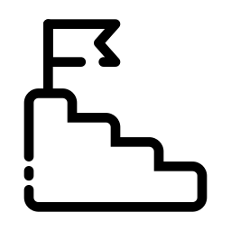
Next Steps
Software
Hardware
Refine Model Training Set
Have ~30 Individuals in Training Set
Update Gesture Sample to be Held for Longer Time Periods
Model Recognizes Multiple Gestures in a Row
If Possible, Gather Data with PCB Board
Gesture Model Recognizes 8 Gestures
Determine Final 8 Best Gestures
8 Gestures Recognized with 90% accuracy
Determine Gesture Letter Assignments and Controls
Combine Hardware Components
Test PCB Board Functionality
Combine PCB with 3D Printed Case
Address and Hardware Design Issues
Word Prediction Model Recognizes Gesture Controls
Upload Gesture Recognition Model to Raspberry Pi
Test Live Gesture Prediction
Connect Predicted Gestures with FlexType Word Predictor
Live Word Prediction has ~60-70% Accuracy

Slide 19

Questions

